Slide 1

City University of Macau
智慧旅遊下的旅遊產業發展思路
庞艺威Echo
赵 晨Niko
曾祥娇Mia

Slide 2

目錄
1、Introduction of Technology
Start-up——NetCraft
2、Introduction of Product
3、Economic and social impact of
NetCraft
4、Macro-environment of
Entrepreneurship

Slide 3

1、Introduction of Technology Start-up

Slide 4
Background
NetCraft Information Technology (Macau) Co. Ltd was established in 1996, as a member of NetCraft Technology Group. Since 1996, NetCraft has achieved significant growth throughout Mainland China. The growth enabled NetCraft to reach major cities including Beijing, Shanghai, Guangzhou and Hong Kong.
NetCraft is recognized to be the leading Information and Communications Technology (ICT) Solution Provider in Macau, specializing in Network & System Infrastructure, Security, Virtualization & Cloud Infrastructure, IT infrastructure management and so forth. Overall, NetCraft's high levels of professional customer service and offered solutions granted optimal trust, and support by their extensive clients especially from the Public and the Private Sectors.
Their relationship with many of the key technology providers ensures they can offer expert independent advice on the most advantageous networking, hardware and software solutions for organization.
To conclude, with persistent effort in carrying out its transformed approach of “Customer-Focused and Service-Oriented” services and solutions, they commit ourselves to deliver the most sophisticated technologies, research and development to serve their clients and the community. They are proud to provide end-to-end integrated IT services to customers that covers IT planning and consultation, design and implementation of software solutions, outsourcing of IT system operations and maintenance, systems integration, equipment rental, IT outsourcing and maintenance services by cooperation with many domestic and international IT vendors and also long term strategic partners.

Slide 5
Business Model

Slide 6
The Latest Development
2017 | NetCraft is pleased to announce that it is the winner of Veeam 「Rising Star ProPartner of the Year 2017」award We would like to take this opportunity to thank you our customers and Veeam's support and trust in the past year. Veeam is providing Backup Solutions across Physical, Virtual and Cloud Platform, Disaster Recovery Solution and Data Center Relocation Services.
2017 | SAFE-T Summit – "Cyber Defense: The New Way Forward" @ Macau Science Centre (1 Dec 2017)

Slide 7

2、Introduction of Product

Slide 8


Introduction of Product
Prices
US$1887~2358
DATA LOSS PREVENTION
PROTECTING YOUR INFORMATION
AND REPUTATION

Slide 9
Introduction of Product
Introduction
Data Loss Prevention
Where does your confidential data live?
Discover
Locate where your sensitive information resides across your cloud, mobile, network, endpoint and storage systems

Slide 10

Introduction of Product
Introduction
Data Loss Prevention
How is it being
used?
Monitor
Understand how your
sensitive information is being used, including what data is being handled and by whom

Slide 11
Introduction of Product
Introduction
Data Loss Prevention
How do you
prevent data loss?
Protect
Stop sensitive information from being leaked or stolen by enforcing data loss policies and educating employees

Slide 12

Introduction of Product
Our approach
Gives you comprehensive coverage across all channels
Cloud
Mobile
On-premise

Slide 13
Introduction of Product
Protects
Your most important, high-value data
Customer Information Company Information
Credit Card Info Intellectual Property
Medical Records
M&A and Strategy
SSNs and Government IDs
Internal Auditing
Financials
HR Records

Slide 14




Introduction of Product
Catch more sensitive data
With advanced content detection technologies
Described Content Matching
Indexed Document Matching
Exact Data Matching
Vector Machine Learning
DESCRIBED DATA
Non-indexable data Lexicons
Data Identifiers
STRUCTURED DATA CUSTOMER DATA
Credit card, Government IDs, Pricing Partial row matching
Near perfect accuracy
UNSTRUCTURED DATA IP
Designs, Source Code, Financials Derivative match
Near perfect accuracy
UNSTRUCTURED DATA IP
Designs, Source Code, Financials Derivative match
Very High Accuracy

Slide 15



Introduction of Product
Respond faster
With sophisticated incident remediation workflow
90% of DLP is Incident Response
Right Automation | Resolution, Enforcement, Notification
Right Person | Route Incidents to Right Responder
Right Order | High Severity of Incidents First
Right Information | 5-Second Test
Right Action | 1-Click Response
Right Metrics | Prove Results to Execs and Auditors

Slide 16
3、Economic and social impact of NetCraft

Slide 17
Economic impact of NetCraft
1、promote the economic structure to rationalization and promote economic development
2、enable economic activities to achieve economies of scale

Slide 18
Social impact of NetCraft
1、Scientific and technological innovation is the key force to promote social development
2、Scientific and technological innovation is a solid foundation for the sustainable development of mankind

Slide 19

4、Macro-environment of
Entrepreneurship

Slide 20
Macao Business Environment
Basic Information about Macao
1、Macao is located on the south-eastern coast of China, along the west
bank of the Pearl River estuary. It is 60km and 145km away from Hong Kong and Guangzhou respectively.
2、Hong Kong-Zhuhai-Macao Bridge built
Development Orientation
1、 World Tourism and Leisure Centre
2、Commercial and Trade Co-operation Service Platform between China and Portuguese-speaking Countries
3、Free port for international trade(Belt and Road)
Economic Situation
1、Recorded stable economic growth(2017Nominal GDP:US$49.9
billon)
2、A low unemployment rate(2.0%)
3、External Trade grew richer
4、setting up more newly incorporated companies (5177 +13.9%)

Slide 21
Economic Situation
1.Macroeconomy
2.Labour Market
2017Nominal GDP：
US$49·9 billion
Inflation Rate：1.23%
Unemployment Rate of Local Residents:2.7%
Non-resident workers:179,456
(+1.02%)
Macroeconomy
Goods
Imports：US$9.38
billion(+6.3%)
ExportskUS$ bi l lion 1(+12.3%)
Services
Imports:US$4·31billon
Exports:US$37·69billion
Newly Incorpoated Companies 5，177（+13·9%）
o
3.Others
4.External Trade
Data source：Macao Tourism Data plus https://dataplus.macaotourism.gov.mo

Slide 22
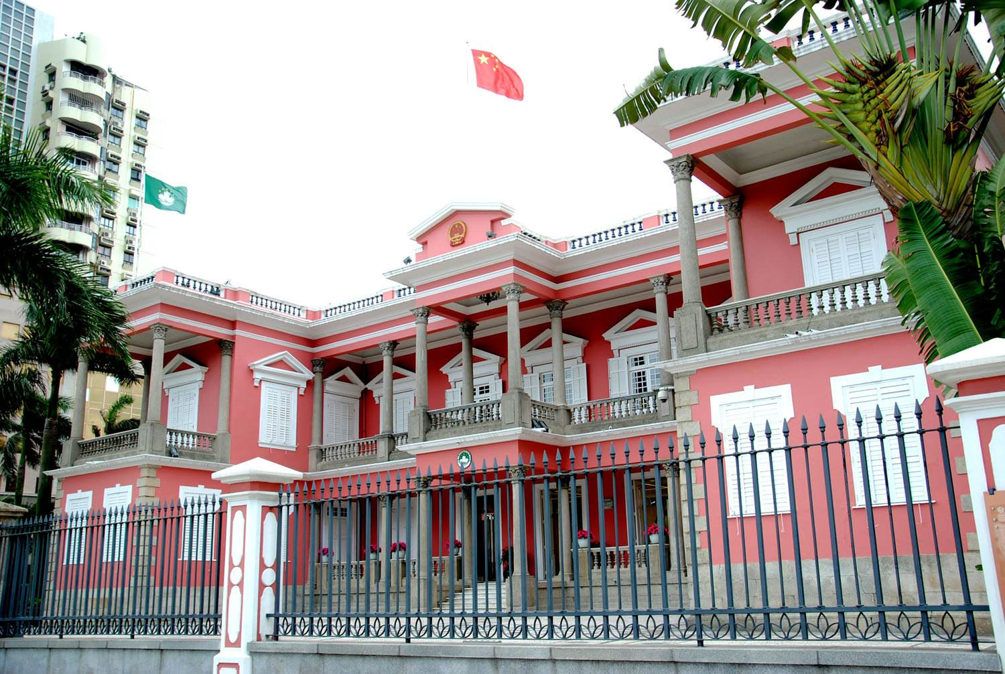
Government Policy
1、Youth Business Assistance Program
2、Specialized notary for the establishment of company and registration procedures

Slide 23

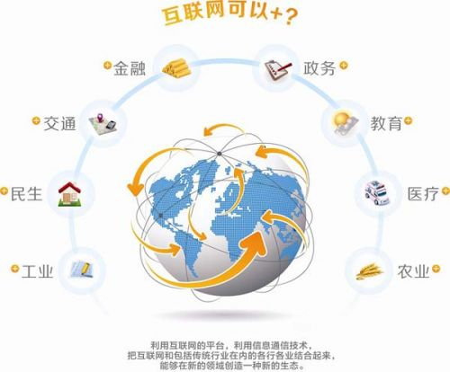
Government Service
1、Online Business Matching Service Platform
Wynn Local SME Procurement Partnership Program-Business Matching Session
Macao Ideas-Macao Branded Products Display and Sourcing Centre
2、One Stop Service
Company registration service;
Co-ordination of public institutions by the Investment Committee ;
Free advice and necessary guidelines for the implementation of your project and assistance in finding local partners.

Slide 24
Q&A

Slide 25
Thanks！

